Slide 1
Network Models: A Short Introduction
CBS 810
Shi Chen and Cristina Lanzas
Notes:
What pops out in your head when you hear the word “network”? Please give me a few examples.

Slide 2
Cattle Contact Networks
Notes:
Propose some more networks : transportation? social? animal? political? bipartite network? vector-host network, marriage

Slide 3
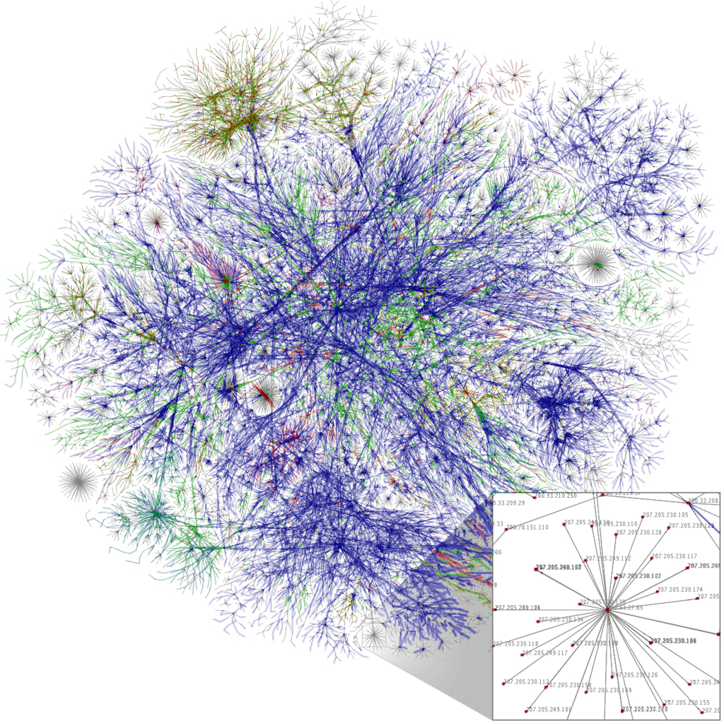
Internet Infrastructure

Slide 4
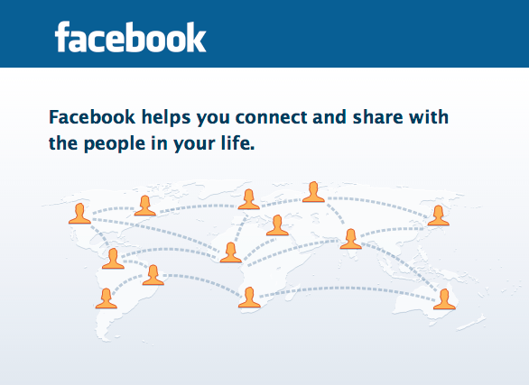
Facebook Network

Slide 5
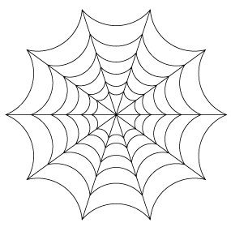
What is a “Network”
Vertex (Node)
Edge (Link)
G = (V,E)
Notes:
vertex: individuals in the network; edge: interactions. physical or virtual

Slide 6
Types of Network
Binary Network (0/1) : Whether OR not connected
Weighted (Valued) Network : How strong is the connection
Directed Network
Undirected Network
Spatially Explicit Network
Spatially Implicit Network
Notes:
Example of directed network? Undirected network? Consider transplant or blood donating: directed.

Slide 7
Sample Network

Slide 8
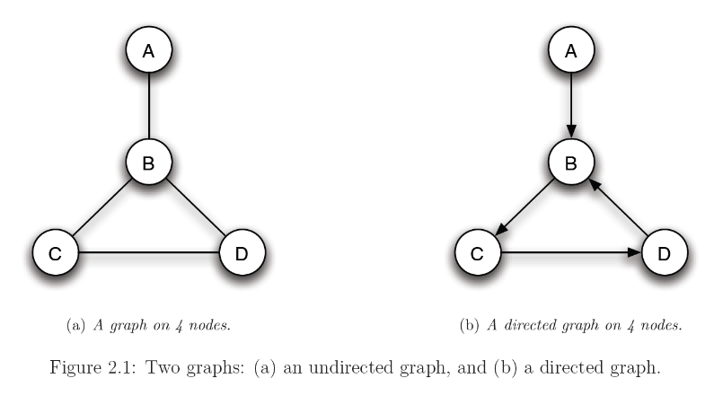
Sample Network 2

Slide 9
Adjacency Matrix
Vertex | V1 | V2 | V3 | V4
V1 | 0
V2 |  | 0
V3 |  |  | 0
V4 |  |  |  | 0
Notes:
A rigorous way to characterize network
Depends on the types of networks. The diagonal (Mii) is always 0. For binary network, it’s either 0 or 1 meaning whether or not. For valued/weighted network, it’s the actual number. For undirected network, Mij=Mji. For directed network, does not necessarily hold.
Now try some exercise – each magnetic circle is your little buddies and you need to construct a network with them. Just use your creativity.

Slide 10
Network Measurements -- Density
Density (d):
Ratio of all observed edges to all possible edges
For a binary network with n vertices and e edges
d= 2e/n(n-1)
Notes:
how to describe the network, e.g. a 10-vertices network has a total of more than 1,000 possible combinations
Some important networks: null, ring, full, and … hello kitty

Slide 11
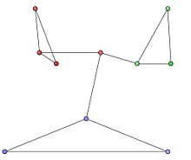
Modularity and Transitivity
Modularity:
Strength of a network being separated to modules/clusters/sub-graphs
Transitivity:
How vertices tend to cluster in triplets

Slide 12
Centrality
Centrality:
Relative importance (influence) of the vertices
Degree-centrality
Closeness-centrality
Eigenvector-centrality

Slide 13
Network Models in Epidemiology
Explicitly consider “WAIFW” information
2001 Foot-and-Mouth Disease epidemics (UK)
2003 SARS epidemics (Asia)
2014 Ebola epidemics (US)
Problems
Resolution (spatial, temporal, etc.)

Slide 14
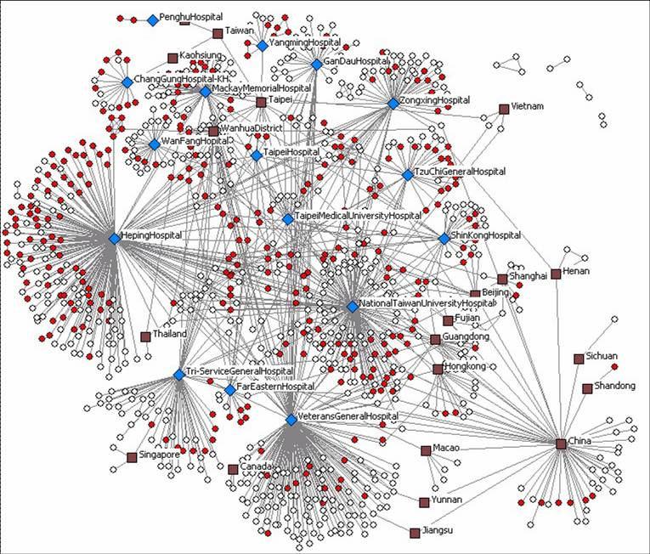
2003 SARS Epidemics in Asia
Notes:
“super-spreader”

